Slide 1
Neutral
Congruent
Incongruent
XXX
红
绿
红色
红色
红色
ins | Block 1 | Rest | ins | Block 2 | Rest | ins | Block 3 | Rest
2.5s | 30s | 30s | 2.5s | 30s | 30s | 2.5s | 30s | 30s
2s | 0.5 | 2s | 0.5 | … 2s (+response) 0.5 ITI 12 trials/block
stim | ITI | stim | ITI
3 run of 3 task blocks and 3 rest blocks
Notes:
Questions:
Are we keeping HCP protocol for n-back task? Is 2s stroop / 2.5s clock stim + resp time enough for stroke patients?
Is XXX neutral condition or should we be using words not associated with colour?
Use 1 char or 2 char colour descriptions?
event-related design to avoid habituation?

Slide 2
Neutral
Congruent
Incongruent
並
紅
綠
紅
紅
紅
ins | Block 1 | Rest | ins | Block 2 | Rest | ins | Block 3 | Rest
2.5s | 30s | 30s | 2.5s | 30s | 30s | 2.5s | 30s | 30s
2s | 0.5 | 2s | 0.5 | … 2s (+response) 0.5 ITI 12 trials/block
stim | ITI | stim | ITI
3 run of 3 task blocks and 3 rest blocks
Words for the neutral condition:並、到、的、個
Notes:
Words for the neutral condition block:
並、到、的、個

Slide 3
Clock test
11:05
右上
ins | Block 1 | Rest | Ins | Block 1 | Rest | ins | Block 1 | Rest | ins | Block 1 | Rest
2.5s | 30s | 30s | 2.5s | 30s | 30s | 2.5s | 30s | 30s | 2.5s | 30s | 30s
2.5s | 0.5 | 2.5s | 0.5 | … 2.5 s (+response) 0.5 ITI 10 trials/block
stim | ITI | stim | ITI
1 run of 8 task blocks and 8 rest blocks
Notes:
Ins includes 2s instructions + 0.5s fixation

Slide 4
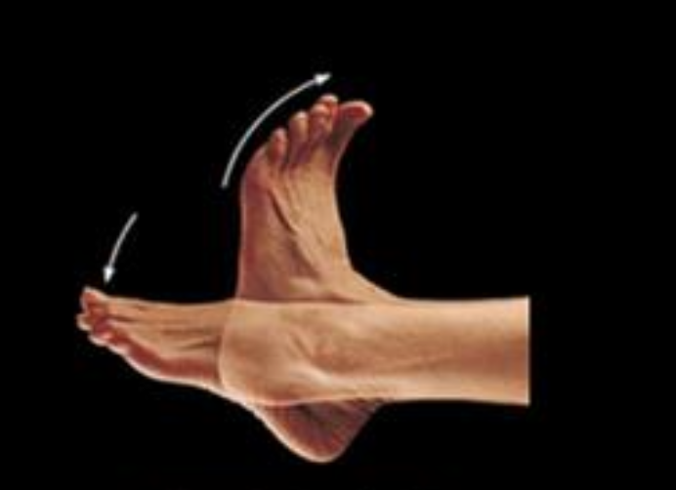
Motor task
请开始一直向下踩踏板
ins | Block 1 | Rest | Ins | Block 1 | Rest | ins | Block 1 | Rest | ins | Block 1 | Rest
2.5s | 30s | 30s | 2.5s | 30s | 30s | 2.5s | 30s | 30s | 2.5s | 30s | 30s
1 run of 8 task blocks and 8 rest blocks

Slide 5
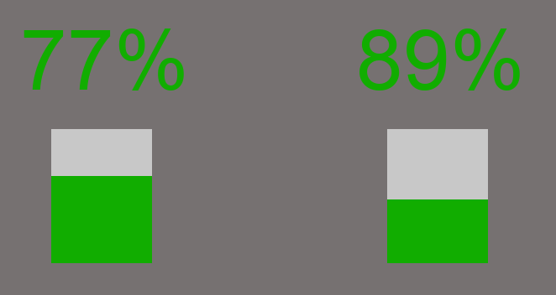
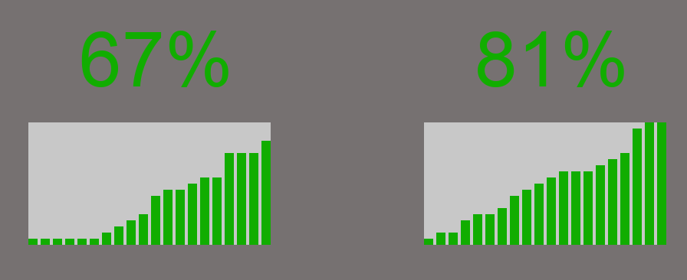
Simple condition
Complex condition
Reward probability
Reward magnitude
1 reward item per option
20 reward items per option
After a decision is made, one reward item will be chosen at random as the reward magnitude for that trial.
1 run of 70 trials, each trial consists of the following:
Intertrial interval | Fixation | Stimulus | Response indication | Random drawing | Reward delivery
1.3-1.9s | 2-4s | 4s max | 1.3-2.3s | 1.3-1.8s | 1.5-2s
Notes:
Each round consists of 2 possible options. Each option has a fixed reward magnitude and an associated probability of obtaining the reward if that option is chosen. For the complex condition, after the participant has made a decision, a reward item will be chosen at random as the reward magnitude for that trial.

